Slide 1
Credit Card Fraud Detection

Slide 2
Credit Card Fraud Detection
Masfik Alam Mahi (1812425642)
Riyadul Islam (1813139042)
Md Lutfor Rahman (1811215642)

Slide 3
Abstract
Due to cashless Transaction every people use ATM card and credit card for transaction, so fraud can also be increase.
Billions of dollars of loss are caused every year by fraudulent credit card transactions. The design of efficient fraud detection algorithms is key for reducing these losses, and more and more algorithms rely on advanced machine learning techniques to assist fraud investigators.

Slide 4
Introduction
► The online shopping growing day to day. Credit cards are used for purchasing goods and services with the help of virtual card and physical card where as virtual card for online transaction and physical card for offline transaction.
► In a physical-card based purchase, the cardholder presents his card physically to a merchant for making a payment. If the cardholder does not realize the loss of card, it can lead to a substantial financial loss to the credit card company. In online payment mode, attackers need only little information for doing fraudulent transaction (secure code, card number, expiration date etc.).

Slide 5
Fraud Detection
Fraud detection is a topic which is applicable to many industries
including banking and financial sectors, insurances, government agencies ,and low enforcement and more. Through the use of sophisticated use of data mining tools ,millions of transaction can be searched to spot patterns and detect fraudulent transaction.
Fraud detection is process of identifying fraud rent transaction.
Credit card fraud detection technic used to recognize fraudulent
credit card transactions so that customers are not charged for
items that they did not purchases.

Slide 6
Technologies used in Machine Learning
Machine learning is the scientific study of algorithms and static
models that computer system use in order to perform a specific task effetely without using the explicit instruction, relaying on patterns and interface instead.
Machine learning algorithms build a mathematical model based on sample data, known as training data in order to make
prediction and decisions.
Machine learning algorithms are used in email filtering, face
recognition, etc.

Slide 7
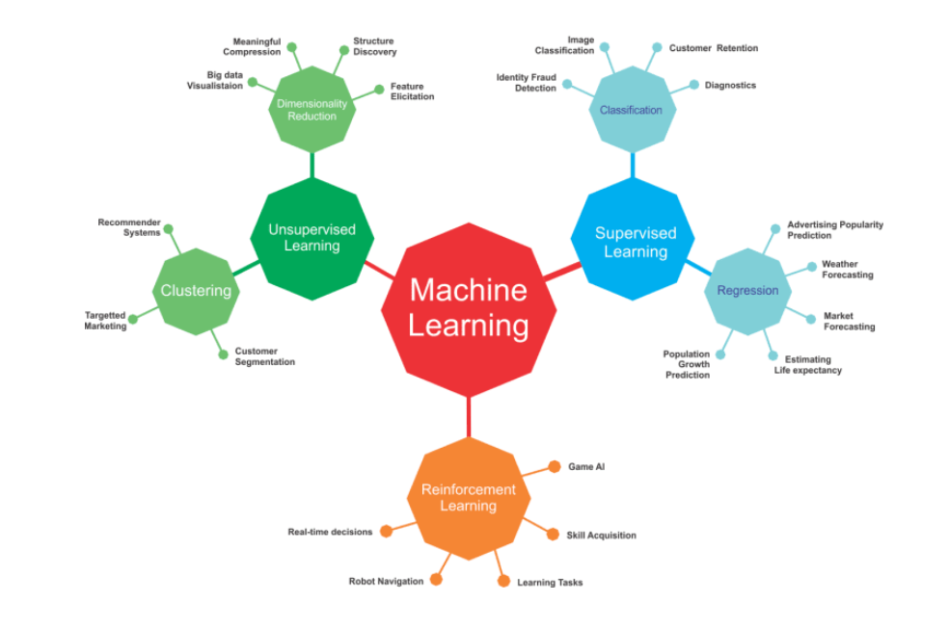
Types of Machine Learning

Slide 8
Algorithm used:
Logistic regression : It is a statistical model that in its basic form uses a logistic function to model a binary dependent variable, although many more complex extensions exist. In regression analysis, logistic regression[1] (or logit regression) is estimating the parameters of a logistic model (a form of binary regression). Mathematically, a binary logistic model has a dependent variable with two possible values, such as pass/ fail which is represented by an indicator variable.
Decision Tree Regression: It build the classification model in the form of a tree structure. It breaks down a dataset into a smaller and smaller subsets while at the same time an associated decision tree in incrementally developed.
Random Forest Regression: It uses ensemble method to solve both regression and classification problems. A Random Forest operates by constructing several decision trees during training time and outputting the mean of the classes as the prediction of all the trees.

Slide 9
MODULES
Module 1: Frame the problem
Module 2: Collect the raw data-Download data from Kaggle.
Module 3: Import the Libraries-Pandas, numpy, sklearn etc.
Module 4: Process the data for analysis.
Perform the logistic regression on data
Explore the data.
Module 5: Perform in-depth analysis.
Module 6: Communicate results of the analysis.

Slide 10
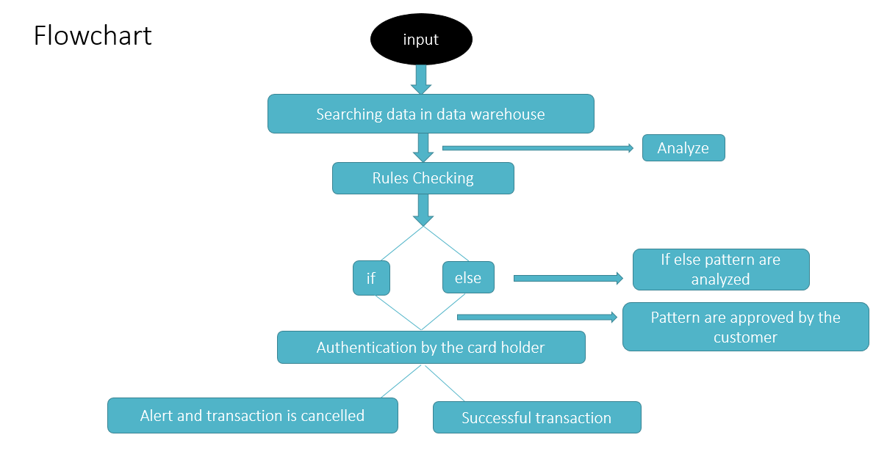

Slide 11
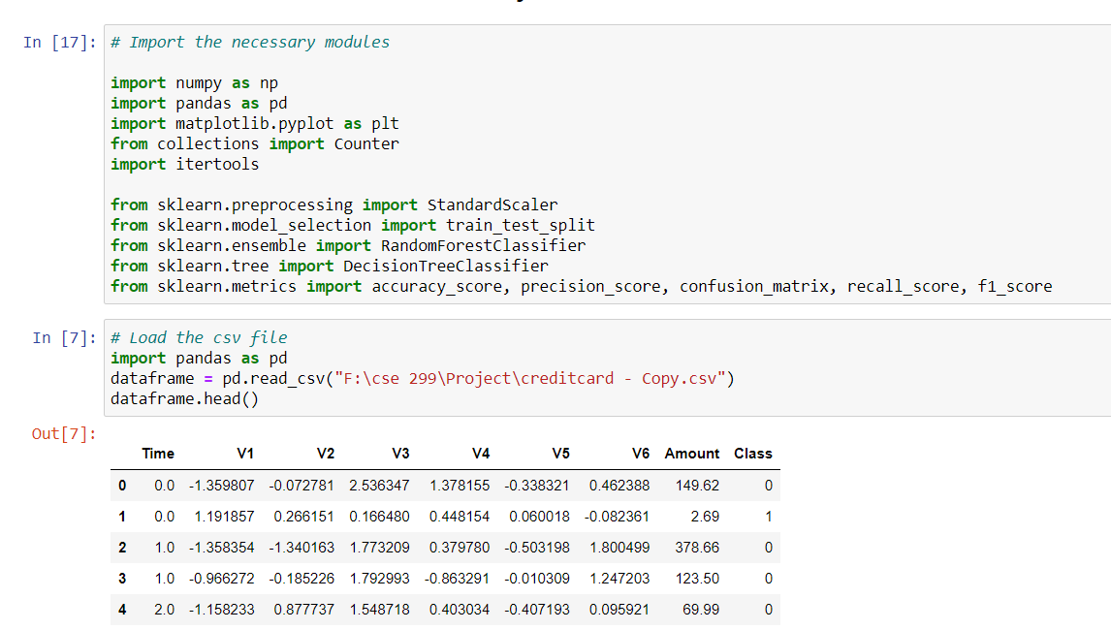
Demonstration of the project

Slide 12
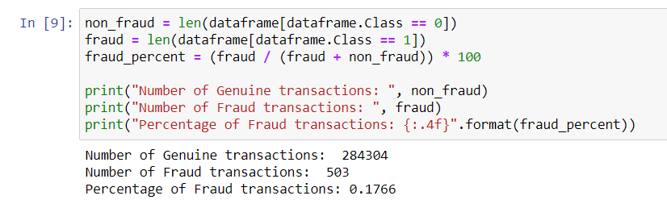
Demonstration of the project

Slide 13
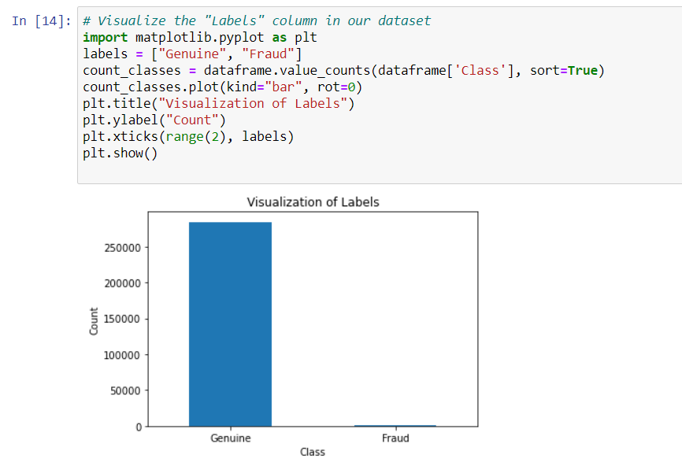
Demonstration of the project

Slide 14
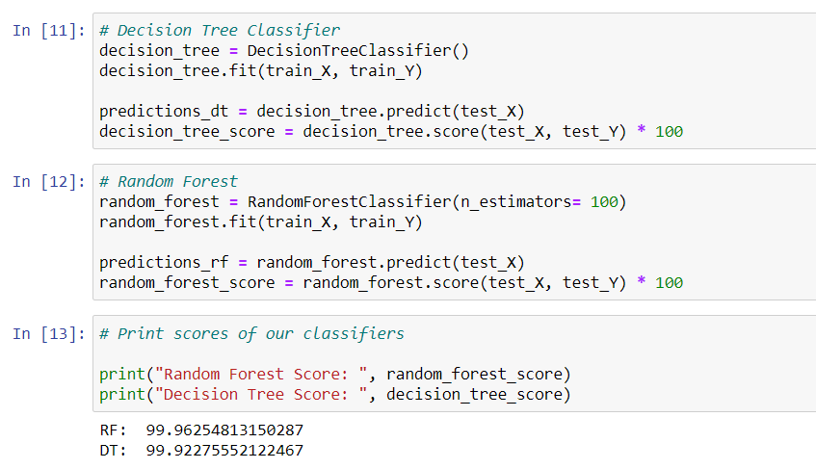
Demonstration of the project

Slide 15
Conclusion and Future Scope
Fraud Detection system have become essential for banks and financial institution, to minimize their losses.
However, there is a lack of published literature on credit card fraud detection techniques, due to the unavailable credit card transaction
dataset for researches.
We designed a system to detect fraud in credit card transaction. This system is capable of providing most of the essential features required to detect fraudulent and legitimate transactions.
The dataset available on day to day processing may become outdated, it is necessary to have updated data for effective fraud behavior identification.

Slide 16
Thank You 🙂

